Slide 1

Quick Sort Algorithm
Ali, James, Daniel Huynh, David, Aiden
Notes:
Aiden

Slide 2

WHAT IS QUICKSORT?
HOW DOES IT WORK?
Notes:
David

Slide 3
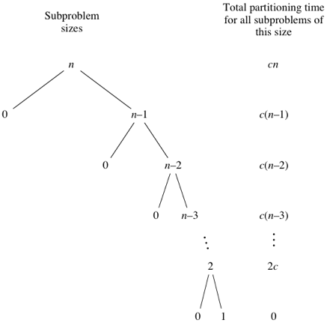
WHAT IS IT?
A very efficient sorting method
Utilizes divide and conquer
List is splitted into halves, halves splitted into more halves, etc.
Until list is sorted
Notes:
David

Slide 4

HOW ARE THE ITEMS REARRANGED
IN QUICK SORT
Notes:
Daniel

Slide 5
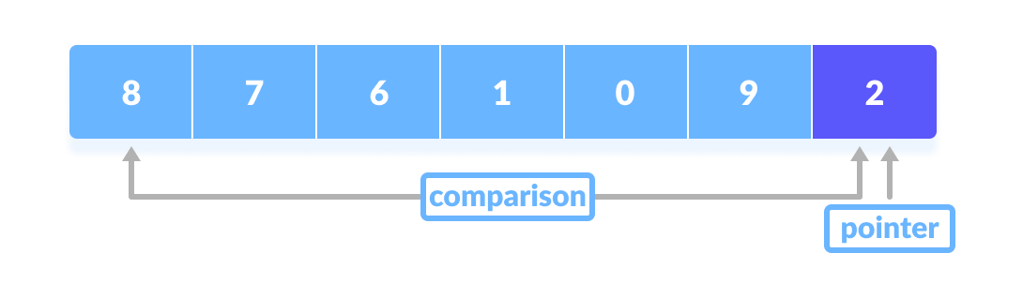
HOW ELEMENTS ARE REARRANGED
All items greater than pivot are moved to one side, less than, moved to the other side
Recurse with a new pivot on each side until the list is sorted
Base case is when there is only one or no elements, where nothing is changed
Notes:
Daniel

Slide 6
Time Complexity
OF QUICK SORT
Notes:
Daniel

Slide 7
QUICKSORT BIG O NOTATION
Best Case:
O (n log n)
When the middle element is always selected as a pivot
Worst Case:
O (n²)
When the pivot selected is always the highest or smallest value
Average:
O (n log n)
Notes:
Aiden

Slide 8

PASSES AND COMPARISONS
IN QUICK SORT
Notes:
James

Slide 9
Greatest or Smallest number as pivot - Worst Case
int [] arr = {1, 2, 3, 4, 5};
1 2 3 4 5
2 3 4 5
3 4 5
4 5
n - 1
n - 2
n - 3
n - 4
(n - 1)n/2 Comparisons
(n - 1)
Passes
Notes:
James

Slide 10
Worst Case Continued: Input ‘n’
Essentially, there are no “confirmed” numbers, number that are in the correct order, to the right of the pivot, making the overall sorting process longer.
n
n-1
0
n-2
0
Notes:
James

Slide 11
Pivot Splits Array Equally - Best Case
int [] arr = {1, 2, 5, 6, 4, 3};
1 2 3 5 6 4
1 2 3 4 5 6
Notes:
james

Slide 12
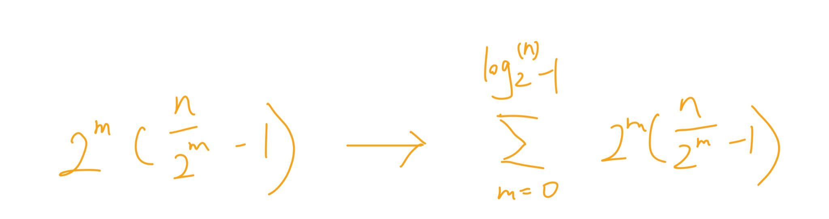
Pivot Splits Array Equally - Best Case
int [] arr = {1, 3, 2, 6, 7, 5, 4};
⌈log₂(n)⌉ Passes
1 3 2 4 5 7 6
1 2 3 4 5 6 7
1(n - 1)
2(n/2- 1)
Notes:
James

Slide 13
Best Case Continued: Input ‘n’
Each pass evenly splits the array. The last pass “confirms” the most amount of numbers.
n
n/2
n/2
n/4
n/4
n/4
n/4
Notes:
james

Slide 14
Best Case Continued: Formula for # of comparisons
Most optimized:
Pivot number is always placed in the middle
Recursive formula:
C(N) = (N-1) + C( ⌊(N-1) / 2)⌋ ) + C( (N-1) - ⌊(N-1) / 2)⌋ )
C(1) return 0;
C(2) return 1;
C(3) return 2;

Slide 15
Formula Sheet
# of | Comparisons | Passes
Best | C(N) = (N-1) + C( ⌊(N-1) / 2)⌋ ) + C( (N-1) - ⌊(N-1) / 2)⌋ ) C(1) return 0; C(2) return 1; C(3) return 2; | P(N) = ⌊N / 2)⌋
Average | C(N) = varies Depends on the pivot points | P(N) = log₂(n)
Worst | C(N) = (N-1) * N/2 | P(N) = (N-1)

Slide 16
Algorithm:
Pick an element as a pivot
Move all the elements greater than the pivot to the right, less than the pivot to the left.
Using recursion, repeat with a new pivot for the partitions before and after the last pivot, until the list is sorted
Notes:
David

Slide 17
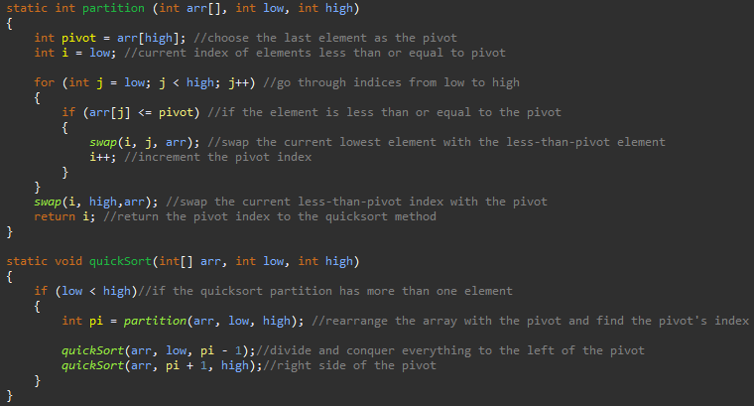
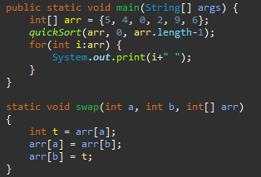
Code Sample
Output:
Notes:
Ali

Slide 18
Visual Guide
Green - Pivot
Red - Greater than Pivot
Blue - Less than or equal to Pivot
Notes:
Ali

Slide 19

Activity 1
5 volunteers please, or we pick...
Notes:
Aiden

Slide 20

Activity 2
Taking up the handout!

Slide 21
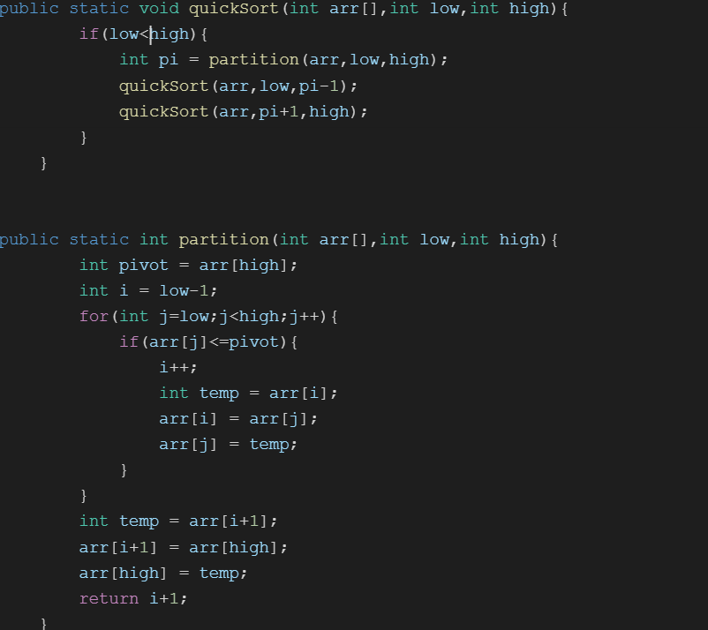
Answers
1. How many passes and comparisons are required to sort the following cases?
“1, 2, 3, 4, 5”
Passes:4 Comparisons:10
“1, 3, 2 ,5, 4”
Passes:3
Comparisons:6
2. Which case has fewer comparisons and why?
The second case has fewer comparisons. This is because when the last number - 4 - is chosen as the pivot, the right side of 4 is in the correct order, thus reducing the number of comparisons. Whereas for case one, there are no numbers to the right of the pivot, thus it requires more comparisons.
3.Fill in the following quicksort methods with pseudo or Java code

Slide 22
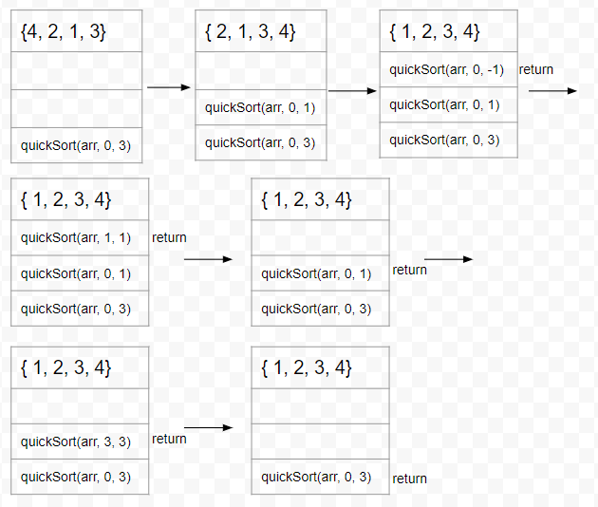
Answers Continued
Draw a stack diagram for quick sorting {4,2,1,3}

Slide 23
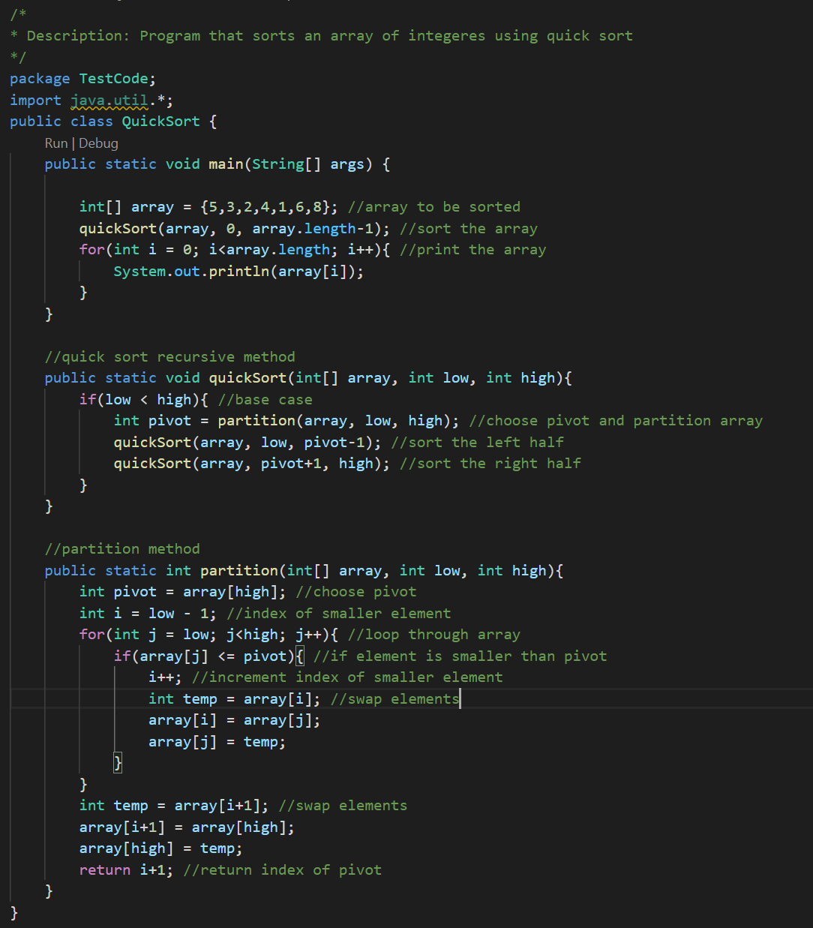
Answers Continued
Write a program that sorts an array of 7 integers in ascending order using quicksort.

Slide 24
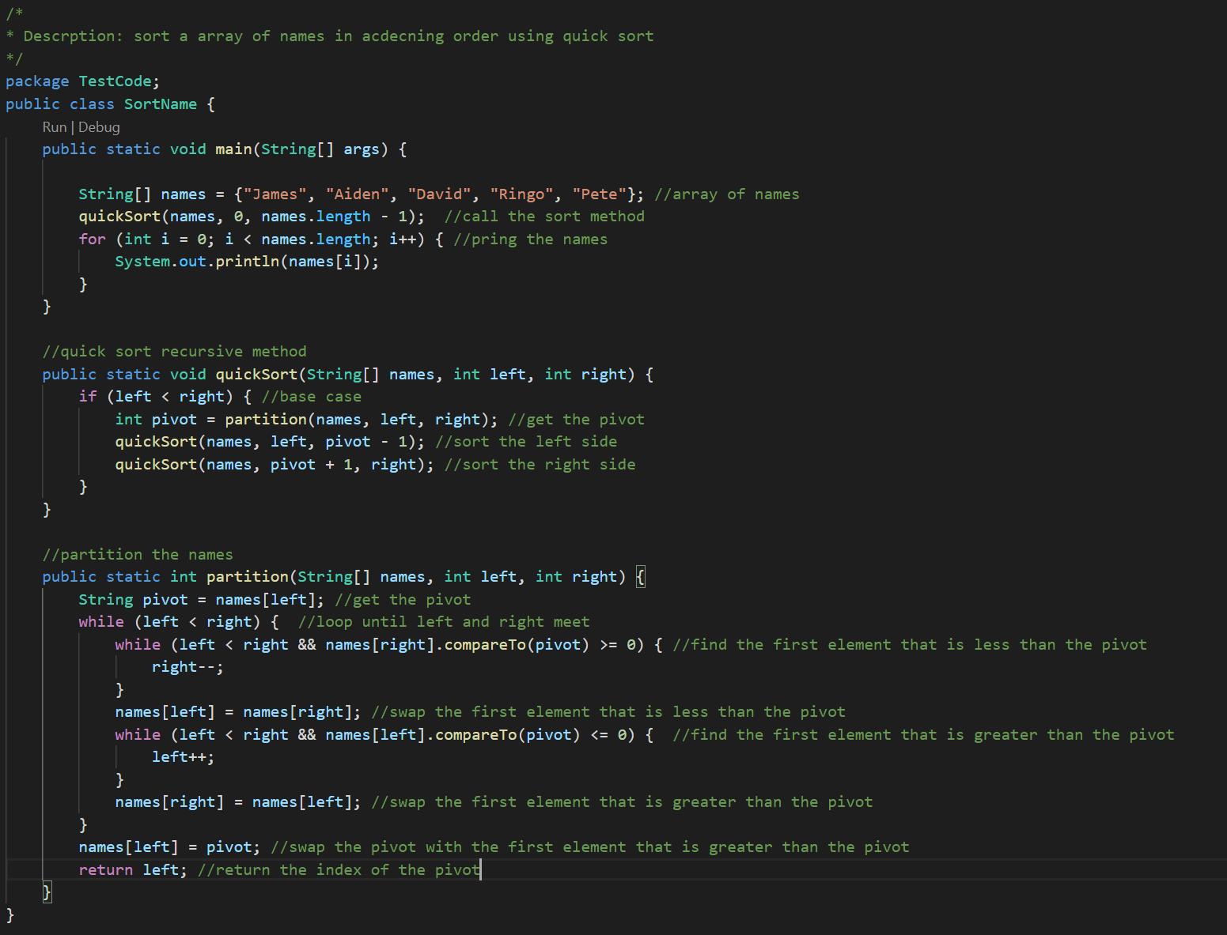
Answers Continued
Write a program that sorts an array of names in ascending order using quicksort.

Slide 25

Activity 3
Homework!!!
Yay

